Slide 1
Course : MOBI8001 – Mobile Technology and Cloud Computing
Mobile Cloud Computing
Session 04
D5727- Dr. Eng. Nico Surantha, ST., MT.

Slide 2
Reference
[1] DE, Debashis. Mobile cloud computing:architectures, algorithms and applications. CRC Press, 2016.
[2] Z. Sanaei, S. Abolfazli, A. Gani, and R. Buyya, Heterogeneity in mobile cloud computing: Taxonomy and open challenges, IEEE Communication Surveys and Tutorials, 16(1), 369–392, 2014.
[3] N. Fernando, S. W. Loke, and W. Rahayu, Mobile cloud computing: A survey. Future Generation Computer Systems, 29(1), 84–106, 2013.

Slide 3
Outline
Introduction
What is Mobile Cloud Computing?
Architecture of Mobile Cloud Computing
Platform and Technologies
Mobile Augmentation Approaches
Issues of Mobile Cloud Computing
Advantages of Mobile Cloud Computing
Applications of Mobile Cloud computing
Conclusion
Bina Nusantara University

Slide 4
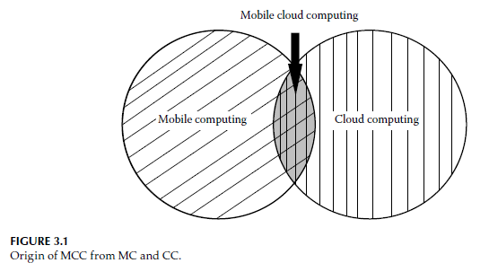
Introduction
Computing through mobile devices still has some drawbacks, e.g. lack of storage, computational power, limited battery.
Cloud computing can provide seamless elastic storage and processing in an “On-demand”, “Pay as you use” that can give solution for mobile device problem.
The integration of both called as mobile cloud computing
Bina Nusantara University

Slide 5
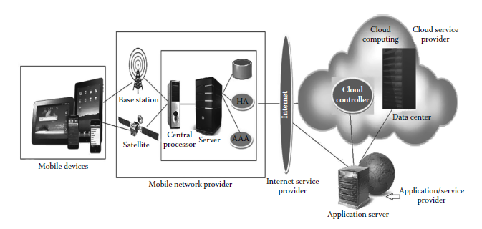
What is MCC?
mobile cloud computing an infrastructure where the data storage and the data processing are performed outside the mobile device but inside the cloud.
Bina Nusantara University

Slide 6
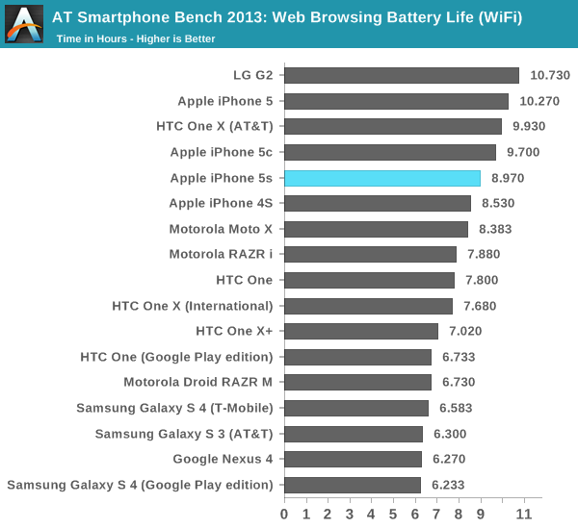
Motivation of MCC
Limited battery life of mobile devices
Reference: http://www.anandtech.com/show/7335/the-iphone-5s-review/9
Notes:
We'll start with our WiFi battery life test. As always, we regularly load web pages at a fixed interval until the battery dies (all displays are calibrated to 200 nits).

Slide 7
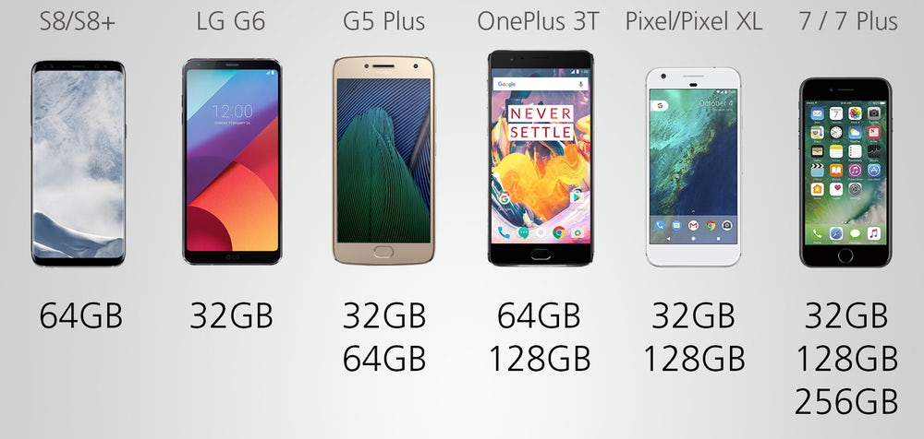
Motivation of MCC (2)
Limited storage capacity of mobile devices
Reference: https://img.newatlas.com/2017-best-smartphones-specs-features-comparison-18.jpg?auto=format%2Ccompress&fit=max&h=670&q=60&w=1000&s=37b5b5ce83f069ea83ec0d715ce73dfa

Slide 8
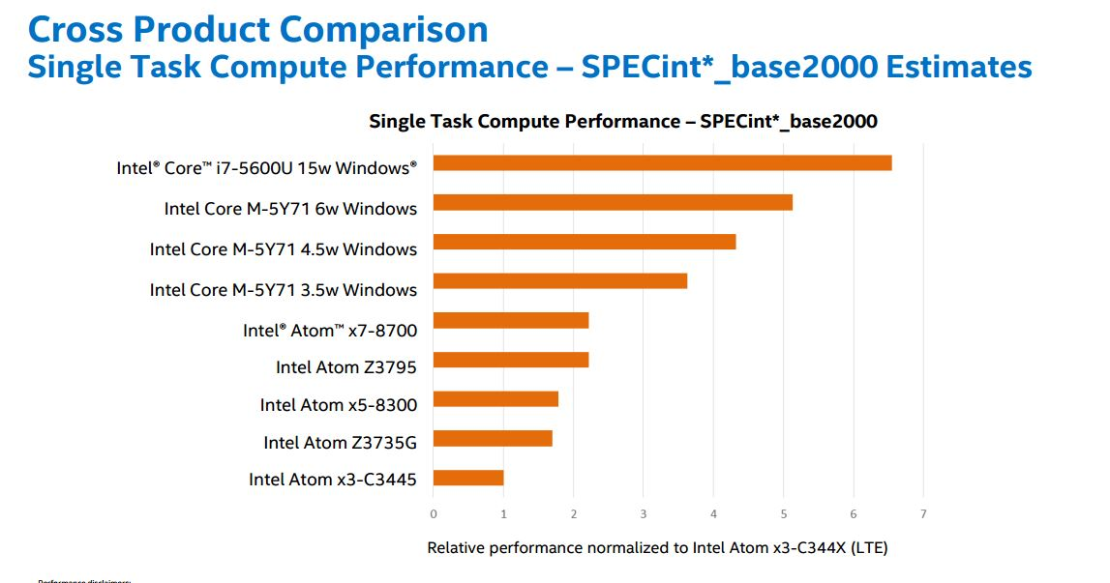
Motivation of MCC (3)
Limited processing power of mobile devices
http://www.umpcportal.com/wp-content/uploads/2015/08/mobile-CPU-performance.jpg

Slide 9
Architecture of Mobile Cloud Computing
Service Oriented Architecture (SOA)
Agent-Client Architecture (ACA)
Collaborative Architecture

Slide 10
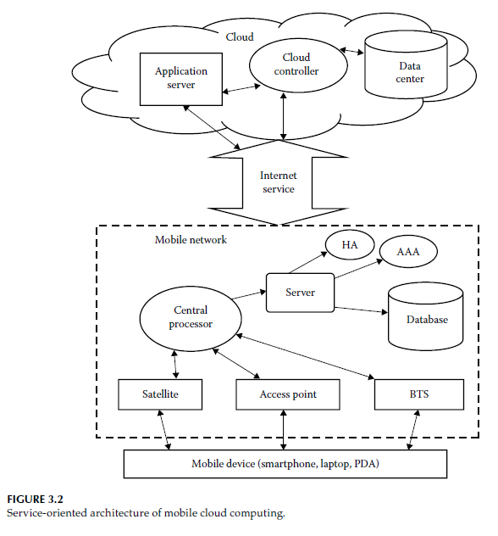
Service-Oriented Architecture
3
2
1
Notes:
Explanation for mobile network;
A mobile device’s request and information, such as ID and location, are transmitted to the central processor and servers of the network providers. Here, operators provides various services such as AAA (authentication, authorization, and accounting) based on the HA (home agent) and subscriber data stored in database.

Slide 11
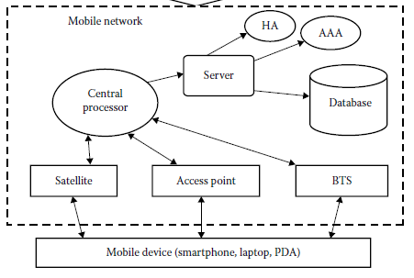
Service-Oriented Architecture (2)
Mobile network: A mobile network contains mobile devices and network operators.
2 components: mobile device and network operator
They are connected by satellite, access point, and BTS.
Operator provides services such as AAA ( authentication, authorization, accounting) based on the Home agent and subscriber data in database
Network operator

Slide 12
Service-Oriented Architecture (3)
Internet service plays a role as a bridge between mobile network and cloud device. Example: wired connection 3G, 4G.

Slide 13
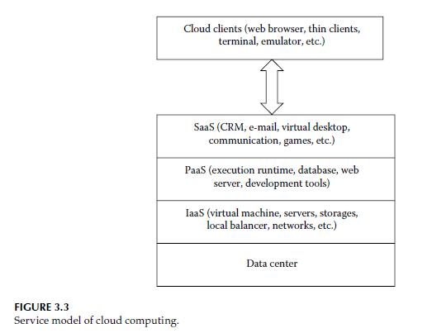
Service-Oriented Architecture (4)
Cloud service:
ex: microsoft 365, CRM, ERP,
ex: Google App engine, microsoft azure
ex: Amazon EC2, S3
Provides hardware facilities and infrastructure for the cloud

Slide 14
Service-Oriented Architecture (4)
This way, in mobile cloud computing, data storage and computations are moved into the cloud
The user gets seamless, on-demand service without having to worry about battery life or the processing power of mobile devices.

Slide 15
Agent-Client Architecture
In this architecture, mobile devices are not connected to the cloud directly.
Usually, clouds are situated at a long distance from the users, so there are chances of delay or cost inefficiency.
These agents can fulfill the user demand with high bandwidth, low latency, and low cost.
Only when the demands are not fulfilled by the agents, the request will go to the cloud.

Slide 16
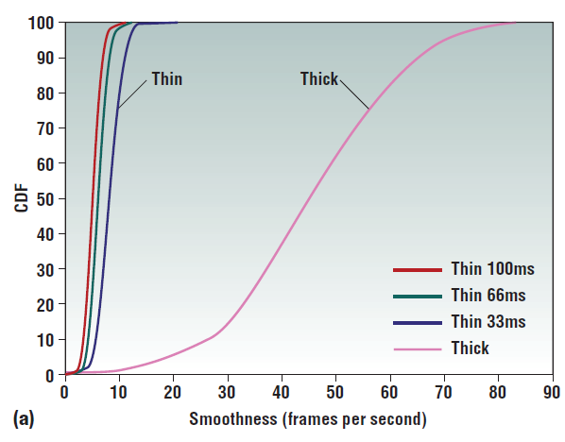
Agent-Client Architecture (2)
a highly interactive visualization application’s measured output frame rate under two different configurations:
“Thick” (a local machine with hardware graphics acceleration) and
“Thin” (a remote compute server on a 100 Mb/s network, with round trip times ranging from 33ms to 100ms)
Network latency hurts interactive performance even with good bandwidth
Ref: M. Satyanarayanan, P. Bahl, R. Caceres, and N. Davies, The case for VM-based cloudlets in
mobile computing, IEEE Pervasive Computing, 8(4), 14–23, 2009.

Slide 17
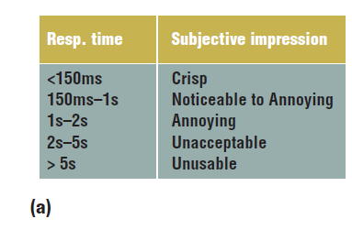
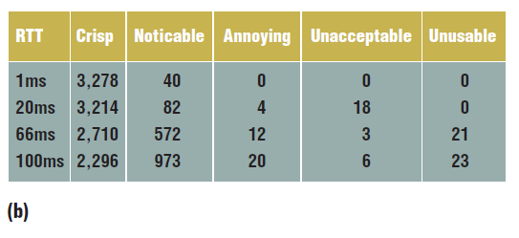
Agent-Client Architecture (3)
Figure 3. Network latency’s effect on usability of photo editing task At 100 Mbps for GIMP on VNC,
(a) the mapping of response times and
(b) the response time distribution of individual GIMP interactions shows that user experience degrades significantly as network latency increases.
Ref: M. Satyanarayanan, P. Bahl, R. Caceres, and N. Davies, The case for VM-based cloudlets in
mobile computing, IEEE Pervasive Computing, 8(4), 14–23, 2009.

Slide 18
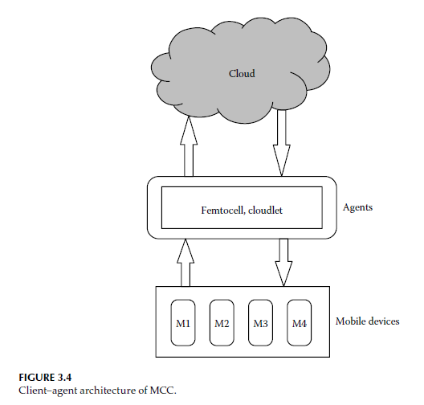
Agent-Client Architecture (4)

Slide 19
Agent-Client Architecture (5)
  Cloudlet: a resource-rich computer or cluster of computers that is trusted and well connected to high-speed Internet and available to mobile devices.
  When a user does not want to offload any task directly to cloud due to delay or cost, he or she can offload it to the nearest available cloudlet.

Slide 20
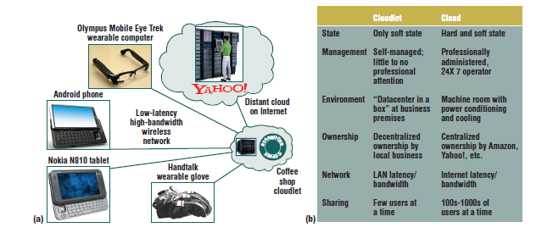
Agent-Client Architecture (6)
Figure 4. What is a cloudlet? (a) The cloudlet concept involves proximate computing infrastructure that can be leveraged by mobile devices; it has (b) some key differences with the basic cloud computing concept.
Ref: M. Satyanarayanan, P. Bahl, R. Caceres, and N. Davies, The case for VM-based cloudlets in
mobile computing, IEEE Pervasive Computing, 8(4), 14–23, 2009.
Notes:
Most importantly, a cloudlet only contains soft state such as cache copies of data or code that’s available elsewhere.

Slide 21
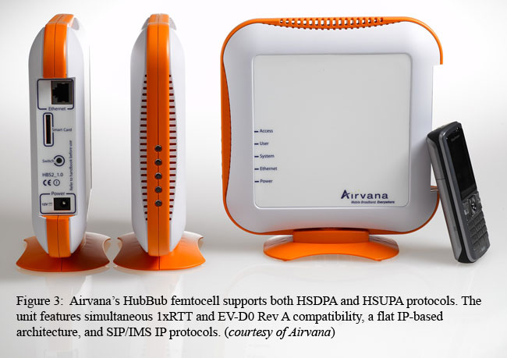
Agent-Client Architecture (7)
Femtocell: well known as the “home base station,” is the smallest version of traditional macrocells.
Mobile devices are connected to femtocells, and femtocells are connected to the mobile network with residential DSL, cable broadband, optical fibers, or wireless 3G/4G.

Slide 22
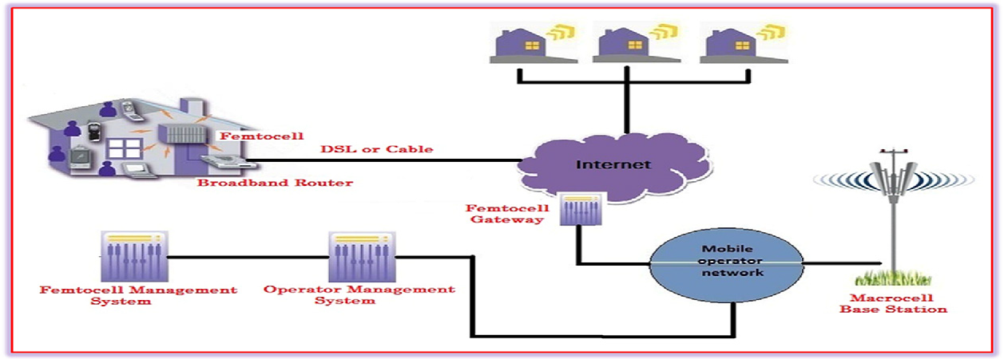
Agent-Client Architecture (8)

Slide 23
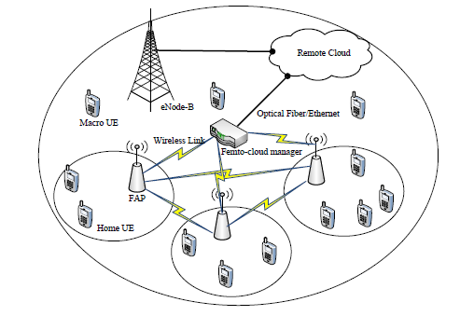
Agent-Client Architecture (9)
Femto-cloud architecture

Slide 24
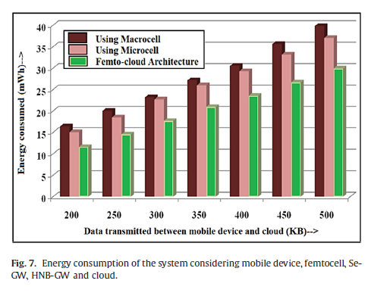
Agent-Client Architecture (10)
Reference: Mukherjee, A., & De, D. (2016). Low power offloading strategy for femto-cloud mobile network. Engineering Science and Technology, an International Journal, 19(1), 260-270.

Slide 25
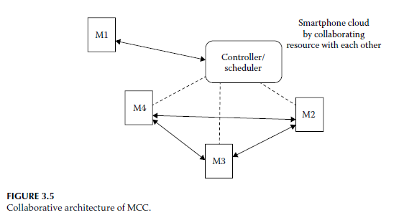
Collaborative Architecture
In this architecture, resources of a mobile device are used by considering the device as a part of a cloud.
The cloud server may be the controller and scheduler for collaboration among the devices.

Slide 26
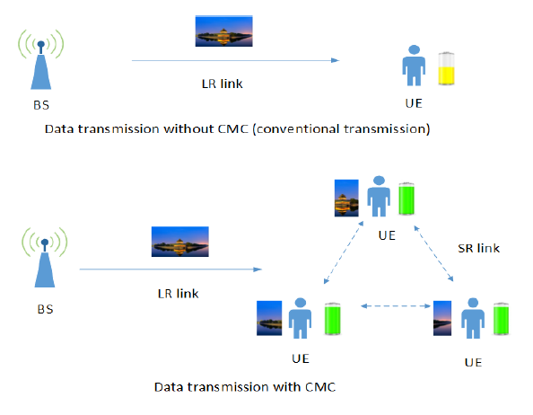
Collaborative Architecture (2)
Note
LR link : long-range link (3G/4G)
SR link : short-range link (bluetooth/WLAN)
Reduce energy consumption
Collaborative download
Collaborative processing for mobile games
Data Transmission with/without CMC

Slide 27
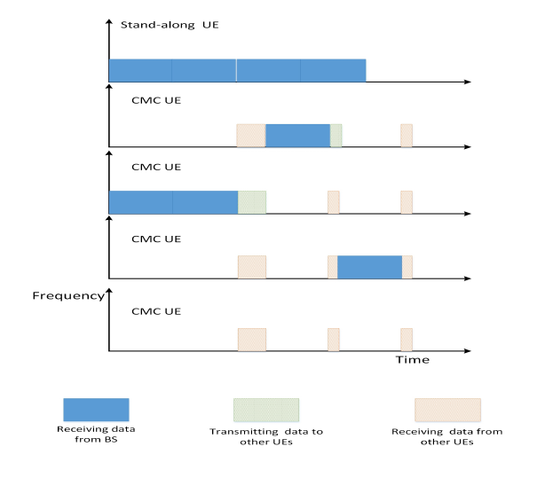
Collaborative Architecture (3)
Note
LR link : long-range link (3G/4G)
SR link : short-range link (bluetooth/WLAN)
Reduce energy consumption
Collaborative download
Collaborative processing for mobile games
Collaborative mobile cloud compared with conventional stand-alone user.

Slide 28
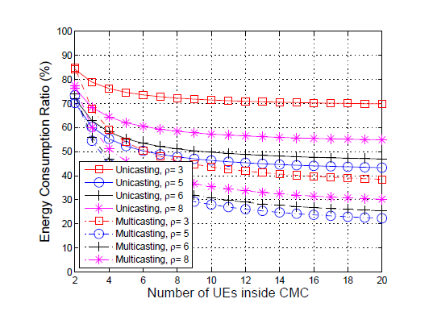
Collaborative Architecture (4)
Note:
the data rate of SR is ρ times better than LR.
Energy consumption with multicasting and with unicasting
Notes:
Moreover, we can also see that there is an optimal value of SR
data rate, i.e., = 5. This is mainly due to the fact that when the data rate is too high, higher
energy consumption is needed for both transmitting and receiving.

Slide 29
Platform and Technologies
Platform of MCC
  Nowadays, tablets and smartphones are the most popular and useful platforms of MCC
  Smartphones use different operating systems such as Research in Motion (RIM), BlackBerry, Windows™ MobileR,, as well as UNIXR variations such as Google Android and Apple iOS made by Samsung, Motorola, and Acer, to support MCC.
Enabling Technologies of MCC
  3G and 4G technology
  HTML 5 and CSS 3
  Web-4.0

Slide 30
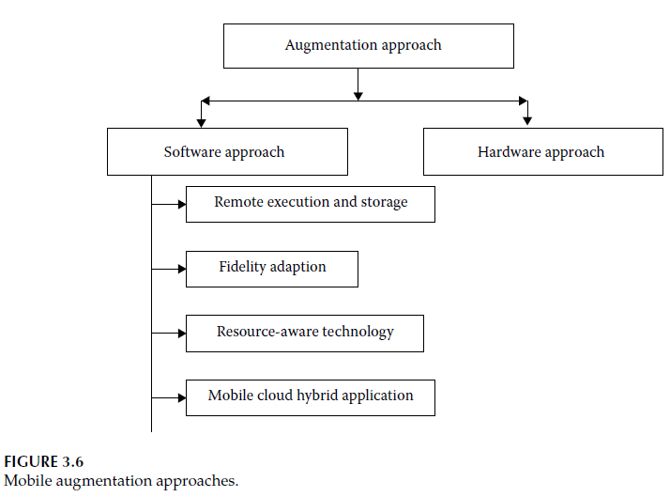
Mobile Augmentation Approaches

Slide 31
Mobile Augmentation Approaches (2)
Resource poverty is the main disadvantage of mobile devices.
Mobile computation augmentation is the process of increasing, enhancing, and optimizing the computing capabilities of mobile devices by leveraging varied feasible approaches, hardware, and software.
Augmentation approaches are classified as follows:
  Hardware approaches, e.g. installing a better processor, RAM, and so on, in the mobile device. However, in many cases, the installation is not easy and it becomes a dedicated installation, so the hardware approach is not viable.

Slide 32
Mobile Augmentation Approaches (3)
  Software approaches,
    Remote execution and storage: migrating [14] the resource-hungry part of the application fully or partially into the nearby cloudlet, remote cloud, or a resource-rich computing machine that is connected to a seamless power source and the Internet.
    Fidelity adaption: provides a tradeoff between application quality and energy conservation of the device, e.g. Youtube provides copies video in some different quality
Notes:
In mobile RAM, the power management unit maintains multiple power states such as “Self Refresh” and “Power Down” to minimize power consumption
PCM leverages three states of
I/O, on and off, to store data with enhanced energy consumption

Slide 33
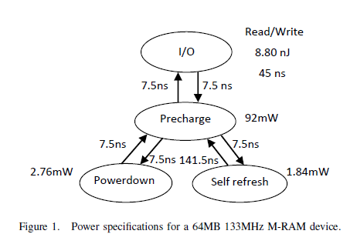
Mobile Augmentation Approaches (3)
  Software approaches,
    Resource-aware technology: ex:
      mobile RAM :
Notes:
In mobile RAM, the power management unit maintains multiple power states such as “Self Refresh” and “Power Down” to minimize power consumption
PCM leverages three states of I/O, on and off, to store data with enhanced energy consumption

Slide 34
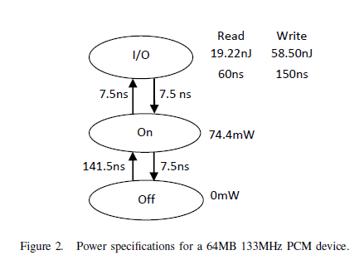
Mobile Augmentation Approaches (4)
  Software approaches,
    Resource-aware technology: ex:
      phase-change memory (PCM):
Notes:
In mobile RAM, the power management unit maintains multiple power states such as “Self Refresh” and “Power Down” to minimize power consumption
PCM leverages three states of I/O, on and off, to store data with enhanced energy consumption

Slide 35
Mobile Augmentation Approaches (4)
  Software approaches,
    Mobile cloud hybrid application: ex: μCloud
Notes:
In mobile RAM, the power management unit maintains multiple power states such as “Self Refresh” and “Power Down” to minimize power consumption
PCM leverages three states of I/O, on and off, to store data with enhanced energy consumption

Slide 36
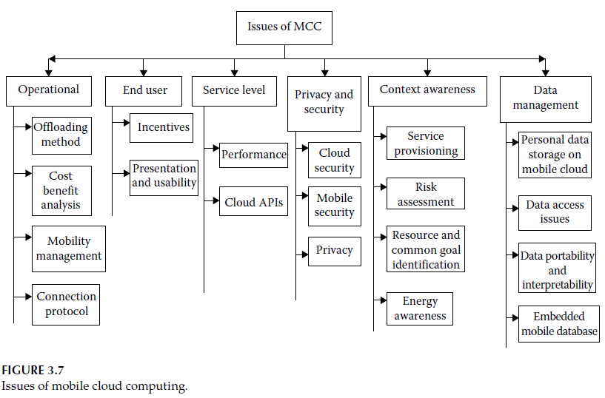
Issues of Mobile Cloud Computing

Slide 37
Operational Issues
Offloading methods
  Client-server communication method:
    Ex: Spectra, Chroma, Hyrax, Cuckoo
  Virtual machine migration
    Ex: MAUI, Clone cloud, MobiCloud
Cost Benefit Analysis
  Total Cost of ownership (TCO): financial estimate to determine the costs associated with owning and managing an IT infrastructure.
  Utilization cost: Utilization cost is the actual cost of using a resource by a user. It is dynamically elastic.

Slide 38
Operational Issues (2)
Mobility Management
  Mobility is one of the reasons for disconnection.
  Localization is very important.
  Infrastructure-based, e.g. Virtual compass, Friends radar. etc
  peer-based technique
Connection Protocol
  Different protocol used,e.g. short-range (WiFi, bluetooth), long-range (3G, 4G)

Slide 39
End User Issues
Incentive scheme
  To motivate them to contribute their resources as cloud or into the cloud.
  Tangible incentive, e.g. money
  Intangible incentive, e.g. name, fame, reputation
Presentation and Usability
  related to the user interface of the mobile device.
  Issues ex: size of screen, touch or non-touch screen device

Slide 40
Service-Level and Application-Level Issues
Fault Tolerance
  Faults occur as a result of the mobility of the device from one network to another, network failure with cloud, running out of battery, hardware failure, and so on.
  Re-execution and redundancy, e.g. Hyrax
Supporting Performance at Service Level
  Limited computational resources, frequent connectivity interruptions, and low bandwidth are the constraints of web services.
  They can be resolved by caching and pre-fetching. This enables a user to do his or her job for a certain period in the offline mode also.

Slide 41
Service-Level and Application-Level Issues (2)
Cloud APIs
  application programming interfaces used to build applications in cloud computing or to use cloud utility.
  ex: funambol cloud API, Dropbox, OpenNebula, Nimbus
Security and Privacy
  General cloud security: regulatory compliance, priviledge user access, data location, etc.
  Security for mobile user: install antivirus
  Privacy: solved by location-trusted server (LTS)

Slide 42
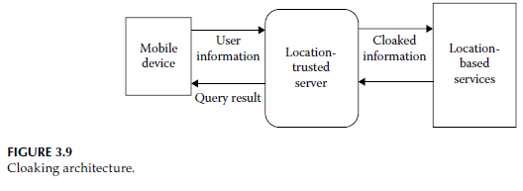
Service-Level and Application-Level Issues (3)
LTS is working between the mobile device and the LBS, it takes information from mobile user and creates a “cloaked region.”
This “cloaked region” is sent to the LBS. Thus, LBS can know only general information about users but cannot identify them.

Slide 43
Context Awareness
Context-Aware Service Provisioning
  Four layer of context element:
    Monitored context, e.g. environmental and device settings, user-specific preference settings, service context information like QoS, and so on.
    Types of gaps, e.g. functional or nonfunctional gaps
    Types of causes, e.g. mismatch of the service level, service interface level, service component level, and component instance level.
    Adapters are needed to remove all the previously mentioned causes.
  context-aware service provisioning has been built with three tiers. The user tier consists of mobile devices where the application runs, the agent tier adapts the services according to the context, and the service tier deploys the services.

Slide 44
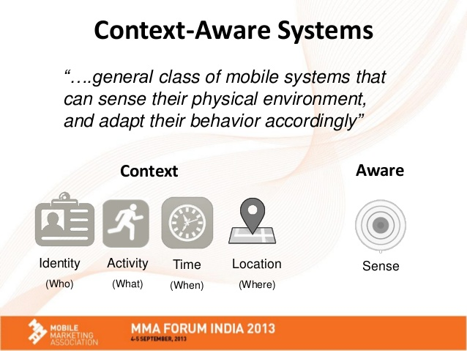

Slide 45
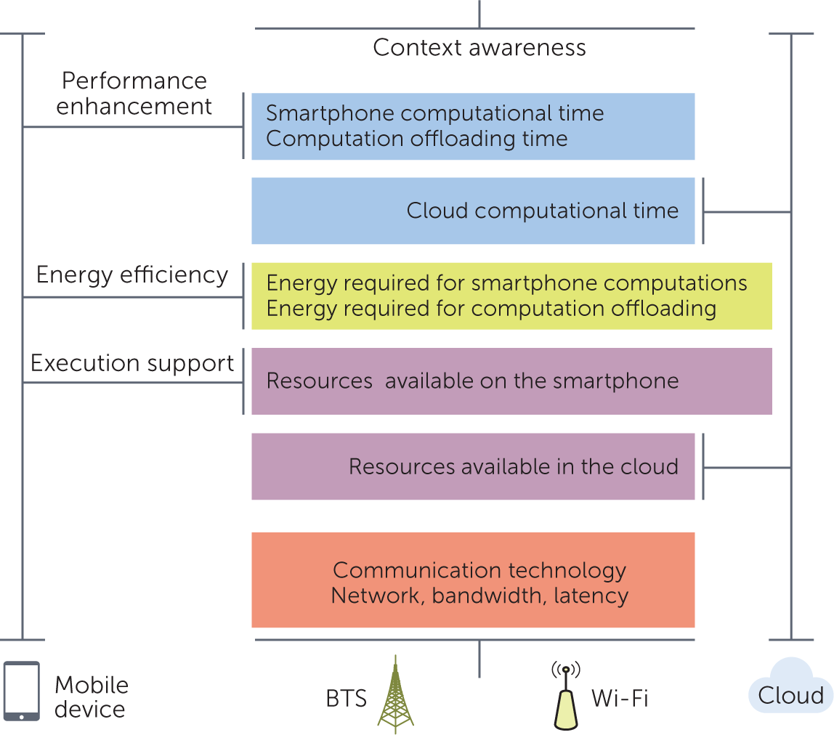

Slide 46
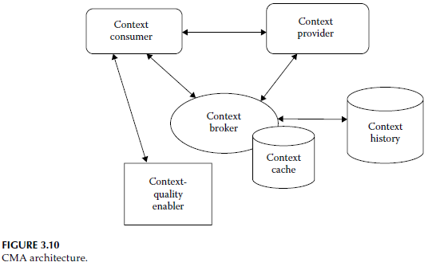
Context Awareness (2)
Component of CMA architecture
  Context provider generates the context information
  Context broker acts as a middleman between the context provider and the context consumer.
  Context consumer These are the entities that take context data as inputs for their actual functionality

Slide 47
Context Awareness (3)
  Risk Assessment Using Context Awareness
  MobiCloud [19] uses context information to facilitate risk assessment and routing decisions by virtual trusted and provisioning domain (VTaPD).
  Various pieces of context information such as device sensing value, location, neighboring device status, and so on, are recorded at VTaPD and used for risk management and intrusion detection.

Slide 48
Context Awareness (4)
Resource and Common Goal Identification Using Context Awareness
  The context manager can sense and store context information, which can be used by other components.
  Using the information context, the application manager can launch, intercept, and modify the current applications.
  The location and the number of devices in a vicinity are considered the main context information.
  Location context is used for tracing the mobility of the user, and a number of devices are used for forming the mobile cloud, so, the system is aware of when a new node enters or leaves the system and also can identify which node is stable.

Slide 49
Context Awareness (5)
Energy Awareness
  Mobile devices have a finite power source, and running many applications constantly causes a large amount of battery drain.
  In MCC, the power consumption must be less than the benefit gained
  So, energy profiling and energy usage estimation of the device are very important.
  Example of energy profiling tool: PowerScope, PowerSpy
  Energy usage estimation is just opposite of energy profiling. It is the prior estimation of an application not during runtime but at the construction time.

Slide 50
Mobile Data Management
Personal data storage on mobile cloud
  Mobile clouds are much safer and easier for managing data than the traditional cloud, as a limited number of users are involved in this case.
  Ex: SkyDrive, iCloud
Data access
  In MCC, data are stored into cloud because of the limited storage, power, and computation power of the mobile device, but still it sometimes faces a bandwidth and connectivity problem.
  Pocket Cloudlet is one of the solution
Notes:
Pocket cloudlet: a local storage cache based on nonvolatile memory
is used to store parts or full cloud services in the mobile device. Here, the device has to
decide previously which portion of the cloud is needed to cache locally.

Slide 51
Mobile Data Management (2)
Data portability and interoperability
  Mobile cloud is compatible with assorted mobile devices such as Android, BlackBerry, iPhone, and so on.
  Considering data interoperability, a Palm Pre user [39] faces problems when Apple’s iTune disables the Palm Pre’s ability to sync its multimedia with iTunes software.
  In case of Funambol cloud service from iPhone, only syncing contacts are allowed. by the apple SDK through the official client. Though it is possible to sync the calendar with SQLite database, the iPhone has to be unlocked, which makes the warranty void.
Notes:
Pocket cloudlet: a local storage cache based on nonvolatile memory
is used to store parts or full cloud services in the mobile device. Here, the device has to
decide previously which portion of the cloud is needed to cache locally.

Slide 52
Mobile Data Management (3)
Embedded mobile database
  In embedded mobile database [40], or simply mobile database, cannot provide all the features of a traditional database to a user.
  Mobile databases are usually integrated with the operating system and specific applications similar to traditional databases, but they are directly driven by procedure calls and designed for data storage for persistent media.
  SQLite is an example of such a database used in Android, iPhone, and web browsers such as Mozilla Firefox.
Notes:
Pocket cloudlet: a local storage cache based on nonvolatile memory
is used to store parts or full cloud services in the mobile device. Here, the device has to
decide previously which portion of the cloud is needed to cache locally.

Slide 53
Advantages of Mobile Cloud Computing
Extending battery lifetime
Extending storage capacity
Extending processing power
High reliability
On-demand service

Slide 54
Applications of Mobile Cloud computing
Mobile commerce
Mobile learning
Mobile gaming
Mobile health monitoring

Slide 55
Conclusion
MCC is a mixture of mobile computing and cloud computing.
MCC provides a simple infrastructure for mobile applications and services by performing both data storage and data processing outside the mobile devices and in the cloud. This, in turn, reduces the energy consumption of the mobile device.
Moreover, using the Internet, different applications such as m-commerce, m-learning, m-healthcare, and m-gaming can be accessed by the mobile device with limited storage capacity and battery life.
Resource poverty, latency, bandwidth, mobility management, security, QoS, and so on are the critical issues in MCC.

